Slide 1
CONFIGURING SERVERS

Slide 2
Completing Post Installation Configuration

Slide 3
Completing post installation tasks
Windows Server 2012 R2 contains a variety of tools that have been overhauled to facilitate remote server management capabilities.
The new Server Manager, for example, is designed to enable administrators to manage Windows servers without having to interact directly with the server console, either physically or remotely.

Slide 4
Completing post installation tasks (Contd.,)
However, there are some tasks that administrators might have to perform immediately after the operating system installation that require direct access to the server console:
Configuring the network connection
Setting the time zone
Enabling Remote Desktop
Renaming the computer
Joining a domain

Slide 5
Using GUI tools
To complete any or all of the post installation configuration tasks on a GUI Windows Server 2012 R2 installation, you can use the tools in the Properties tile, either by working directly at the server console or by using Remote Desktop to access the server from another computer.

Slide 6
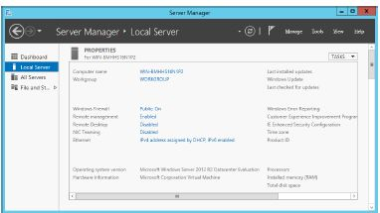
Using GUI tools (Contd.,)
Fig: The Properties tile of the local server in Server Manager

Slide 7
Using command-line tools
If you selected the Server Core option when installing Windows Server 2012 R2, you can perform the same post installation tasks from the command line.
At the very minimum, you will have to rename the computer and join it to a domain.
To do this, you can use the Sconfig.cmd or Netdom.exe program.

Slide 8
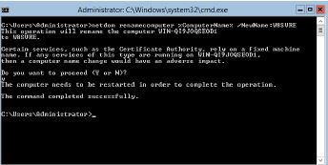
Using command-line tools (Contd.,)
Fig: Renaming a computer from the command line

Slide 9
Converting between GUI and Server Core

Slide 10
Converting between GUI and Server Core
In Windows Server 2012 R2, you can convert a computer installed with the full GUI option to
Server Core and add the full GUI to a Server Core computer.
This is a major improvement in the usefulness of Server Core over the version in Windows Server 2008 R2, in which you can only change the interface by reinstalling the entire operating system.
With this capability, administrators can install servers with the full GUI, use the graphical tools to perform the initial setup, and then convert them to Server Core to conserve system resources.

Slide 11
Converting between GUI and Server Core (Contd.,)
If it later becomes necessary, it is possible to reinstall the GUI components.
To convert a full GUI installation of Windows Server 2012 R2 to Server Core by using Server Manager, you must run the Remove Roles And Features Wizard and uninstall the following features, as shown in Figure.
Graphical Management Tools And Infrastructure
Server Graphical Shell

Slide 12
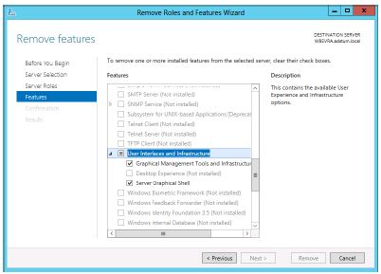
Converting between GUI and Server Core (Contd.,)
Fig: Uninstalling features using the Remove Features page in Server Manager

Slide 13
Converting between GUI and Server Core (Contd.,)
To convert a Windows Server 2012 R2 Server Core installation to the full GUI option, use the following Windows PowerShell command:
Install-WindowsFeature Server-Gui-Mgmt-Infra,Server-Gui-Shell –Restart
To convert a full GUI server installation to Server Core, use the following command:
Uninstall-WindowsFeature Server-Gui-Mgmt-Infra,Server-Gui-Shell -Restart

Slide 14
Configuring NIC teaming

Slide 15
Configuring NIC teaming
NIC teaming is a feature in Windows Server 2012 R2 that enables administrators to combine the bandwidth of multiple network interface adapters, providing increased performance and fault tolerance.
Virtualization enables administrators to separate vital network functions on different systems without having to purchase a separate physical computer for each one.
However, one of the drawbacks of this practice is that a single server hosting multiple VMs is still a single point of failure for all of them.
A single malfunctioning network adapter, a faulty switch, or even an unplugged cable can bring down a host server and all its VMs.

Slide 16
Configuring NIC teaming (Contd.,)
NIC teaming, also called bonding, balancing, and aggregation, is a technology that has been available for some time, but it was always tied to specific hardware implementations.
The NIC teaming capability in Windows Server 2012 R2 is hardware independent and enables you to combine multiple physical network adapters into a single interface.
The results can include increased performance by combining the throughput of the adapters and protection from adapter failures by dynamically moving all traffic to the functioning NICs.
Notes:
bonding it is a term used to describe a way to increase available bandwidth. Linux uses a special kernel module called bonding to allow users to bond multiple network interfaces into a single channel. NIC bonding may also be called NIC Teaming.
Link aggregation, load balancing, link bonding is computer networking umbrella terms to describe various methods of aggregating multiple network connections in parallel links to increase throughput beyond what a single connection could sustain, and to provide redundancy in case one of the links fails.

Slide 17
Configuring NIC teaming (Contd.,)
NIC teaming in Windows Server 2012 R2 supports two modes:
Switch Independent. With Switch Independent mode, the switch or switches to which the NIC Team members are connected are unaware of the presence of the NIC team and do not determine how to distribute network traffic to NIC Team members - instead, the NIC Team distributes inbound network traffic across the NIC Team members.
Switch Dependent. With Switch Dependent modes, the switch to which the NIC Team members are connected determines how to distribute the inbound network traffic among the NIC Team members. The switch has complete independence to determine how to distribute the network traffic across the NIC Team members.

Slide 18
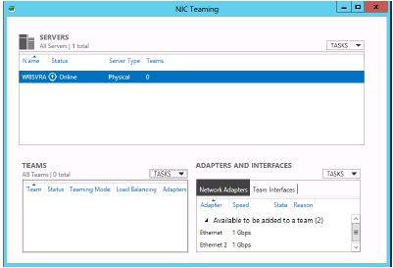
Steps to configure NIC Teaming
In Server Manager, in the Properties tile, click NIC Teaming. The NIC Teaming window opens, as shown in Figure.

Slide 19
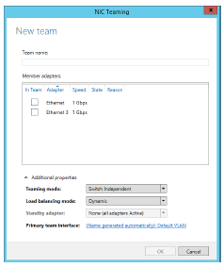
Steps to configure NIC Teaming (Contd.,)
In the Teams tile, click Tasks and select New Team to open the New Team page.
Click the Additional Properties arrow to expand the window, as shown in Figure.

Slide 20
Steps to configure NIC Teaming (Contd.,)
In the Team Name text box, type the name you want to assign to the team.
In the Member Adapters box, select the network adapters you want to add to the team.
In the Teaming Mode drop-down list, select one of the following options:
Static Teaming
Switch Independent
LACP
In the Load Balancing Mode drop-down list, select one of the following options:
Address Hash
Hyper-V Port
Dynamic
Notes:
Switch Dependent.:
Static Teaming Requires you to manually configure both the switch and the host to identify which links form the team. Because this is a statically configured solution, there is no additional protocol to assist the switch and the host to identify incorrectly plugged cables or other errors that could cause the team to fail to perform. This mode is typically supported by server-class switches.
Link Aggregation Control Protocol (LACP)Unlike Static Teaming, LACP Teaming mode dynamically identifies links that are connected between the host and the switch. This dynamic connection enables the automatic creation of a team and, in theory but rarely in practice, the expansion and reduction of a team simply by the transmission or receipt of LACP packets from the peer entity. All server-class switches support LACP, and all require the network operator to administratively enable LACP on the switch port. When you configure a Teaming mode of LACP, NIC Teaming always operates in LACP's Active mode with a short timer. No option is presently available to modify the timer or change the LACP mode.
Address Hash - Load balances outbound network traffic across all active NICs, but only receives inbound traffic via one of the NICs in the team. Since the switch isn't actively involved in the "Switch Independent" teaming mode, it can't load balance inbound traffic across all active NICs. This mode can work well if your server has little traffic inbound and lots of traffic outbound that you are trying to load balance - Web servers and FTP servers are examples of typical server roles that work well in this scenario.
Hyper-V Port - If your server is a Hyper-V host with multiple running VMs, this load balancing mode is normally preferred in most situations. When using "Hyper-V Port" load balancing, VM's will be distributed across the network team and each VM's outbound and inbound traffic will be handled by a specific active NIC. This mode works really well in scenarios where you are consolidating many VM's on a physical Hyper-V host, but where none of the VM's are generating a network load that exceeds the bandwidth of one NIC in the team. In this use case, NIC teaming provides a very cost-effective way of load balancing the aggregate traffic from all VMs across the active team members, but remember ... each VM is assigned to a specific NIC in the team, so none of the VM's will be able to access more bandwidth than what one NIC provides.

Slide 21
Steps to configure NIC Teaming (Contd.,)
If you selected Switch Independent for the Teaming Mode value, use the Standby Adapter drop-down list to select one of the adapters to function as the offline standby.
Click OK. The new team is listed in the Teams tile, as shown in Figure 1-9.

Slide 22
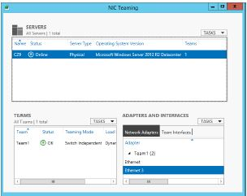
Steps to configure NIC Teaming (Contd.,)

Slide 23
Adding servers

Slide 24
Adding servers
The Server Manager interface consists of a navigation pane on the left containing icons representing various views of server resources.
Selecting an icon displays a home page in the right pane, which consists of a number of tiles containing information about the resource.
The Dashboard page, which opens by default, contains, in addition to the Welcome tile, thumbnails that summarize the other views available in Server Manager, as shown in Figure.
These other views include a page for the Local Server, one for All Servers, and others for server groups and role groups.

Slide 25
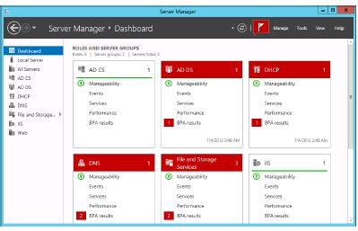
Adding servers (Contd.,)

Slide 26
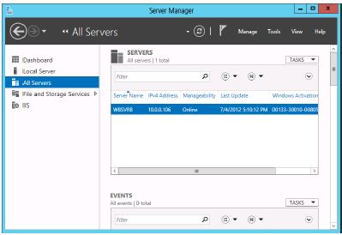
Steps for Adding servers (Contd.,)
Open Server Manager and, in the navigation pane, click All Servers.
The All Servers home page opens, as shown in Figure.

Slide 27
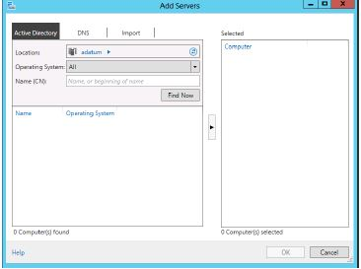
Steps for Adding servers (Contd.,)
From the Manage menu, select Add Servers. The Add Servers dialog box opens, as shown in Figure.

Slide 28
Steps for Adding servers (Contd.,)
Select one of the following tabs to specify how you want to locate servers to add:
Active Directory Enables you to search for computers running specific operating systems in specific locations in an Active Directory Domain Services domain
DNS Enables you to search for servers in your currently configured Domain Name System (DNS) server
Import Enables you to supply a text file containing the names of the servers you want to add

Slide 29
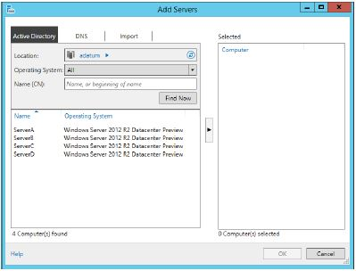
Steps for Adding servers (Contd.,)
Initiate a search or upload a text file to display a list of available servers, as shown in Figure.

Slide 30
Steps for Adding servers (Contd.,)
Select the servers you want to add and click the right arrow button to add them to the Selected list.
Click OK. The servers you selected are added to the All Servers home page.

Slide 31
Adding roles and features

Slide 32
Adding roles and features
The Server Manager program in Windows Server 2012 R2 combines what used to be separate wizards for adding roles and features into one, the Add Roles And Features Wizard.
Once you add multiple servers to the Server Manager interface, they are integrated into the Add Roles And Features Wizard, so you can deploy roles and features to any of your servers.

Slide 33
Steps for Adding roles and features (Contd.,)
To install roles and features by using Server Manager, use the following procedure.
In Server Manager, from the Manage menu, select Add Roles And Features. The Add Roles And Features Wizard starts, displaying the Before You Begin page.
Click Next to open the Select Installation Type page, as shown in Figure.

Slide 34
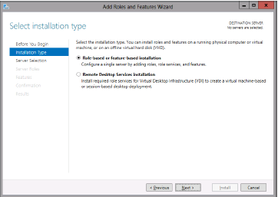
Steps for Adding roles and features (Contd.,)

Slide 35
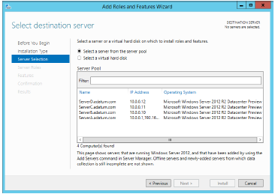
Steps for Adding roles and features (Contd.,)
Leave the Role-Based Or Feature-Based Installation option selected and click Next.
The Select Destination Server page opens, as shown in Figure.

Slide 36
Steps for Adding roles and features (Contd.,)
Select the server on which you want to install the roles or features. If the server pool contains a large number of servers, you can use the Filter text box to display a subset of the pool based on a text string.
When you have selected the server, click Next. The Select Server Roles page opens, as shown in Figure

Slide 37
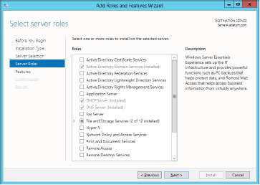
Steps for Adding roles and features (Contd.,)

Slide 38
Steps for Adding roles and features (Contd.,)
Select the role or roles you want to install on the selected server. If the roles you select have other roles or features as dependencies, an Add Features That Are Required dialog box opens.
Click Add Features to accept the dependencies and then click Next to open the Select Features page, as shown in Figure.

Slide 39
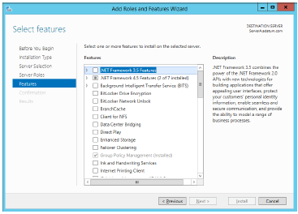
Steps for Adding roles and features (Contd.,)

Slide 40
Steps for Adding roles and features (Contd.,)
Select any features you want to install in the selected server and click Next. Dependencies might appear for your feature selections.
The wizard then displays pages specific to the roles or features you have chosen. Most roles have a Select Role Services page, on which you can select which elements of the role you want to install.
Click Install to open the Installation Progress page. Depending on the roles and features installed, the wizard might display hyperlinks to the tools needed to perform required post installation tasks. When the installation is complete, click Close to complete the wizard.

Slide 41
Deploying roles to VHDs

Slide 42
Deploying roles to VHDs
Server Manager enables administrators to install them to VMs that are currently in an offline state.
For example, you might have an offline web server VM stored on a backup host server, in case the computer hosting your main web server VMs should fail.
Server Manager enables you to select a virtual hard disk (VHD) file and install or remove roles and features without having to deploy the VM.

Slide 43
Steps for Deploying roles to VHDs
To install roles or features to an offline VHD file, use the following procedure.
1. In Server Manager, from the Manage menu, select Add Roles and Features. The Add Roles And Features Wizard starts, displaying the Before You Begin page.
2. Click Next to open the Select Installation Type page.
3. Leave the Role-Based Or Feature-Based Installation option selected and click Next. The Select Destination Server page opens.

Slide 44
Steps for Deploying roles to VHDs (Contd.,)
4. Select the Select A Virtual Hard Disk option. A Virtual Hard Disk text box appears at the bottom of the page.
5. In the Virtual Hard Disk text box, type or browse to the location of the VHD file you want to modify.
6. In the Server Pool box, select the server that the wizard should use to mount the VHD file, as shown in Figure click Next. The Select Server Roles page opens.
7. Select the role or roles you want to install on the selected server, adding the required dependencies if necessary, and click Next. The Select Features page opens.

Slide 45
Steps for Deploying roles to VHDs (Contd.,)
8. Select any features you want to install on the selected server and click Next. Dependencies might appear for your feature selections.
9. The wizard then displays pages specific to the roles or features you have chosen,
enabling you to select role services and configure other settings. Complete each of the role-specific or feature-specific pages and click Next. A Confirmation page opens.
10. Click Install. The Installation Progress page opens. When the installation is complete, click Close to dismount the VHD and complete the wizard.

Slide 46
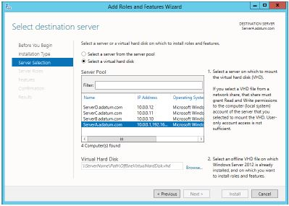
Steps for Deploying roles to VHDs (Contd.,)

